Slide 1

Customer Shopping Behavior Analysis
Uncovering insights from 3,900 purchases to guide strategic business decisions through data-driven analysis of spending patterns, customer segments, and product preferences.

Slide 2
Dataset Overview
3,900
18
37
Total Purchases
Data Features
Missing Values
Transactional records analyzed
Comprehensive customer attributes
In Review Rating column only
Customer Demographics
Shopping Behavior
Age, Gender, Location
Purchase patterns and frequency
Subscription Status
Discount and promo usage
Review ratings and shipping preferences

Slide 3
Data Preparation Journey
01
02
03
Data Loading & Exploration
Missing Data Handling
Feature Engineering
Imported dataset using pandas, examined structure with df.info() and summary statistics.
Imputed 37 missing Review Rating values using median rating per product category.
Created age_group bins and purchase_frequency_days columns for deeper insights.
04
05
Data Consistency
Database Integration
Standardized columns to snake case, dropped redundant promo_code_used field.
Connected to PostgreSQL and loaded cleaned data for SQL analysis.

Slide 4
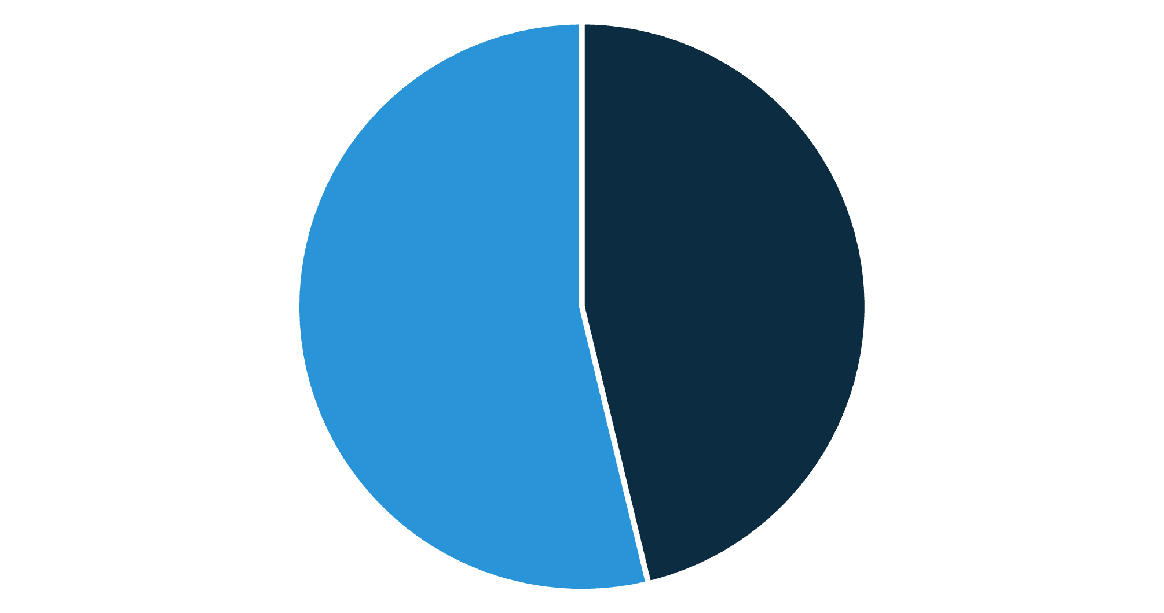
Revenue Insights by Gender
Gender Revenue Distribution
Female customers generated slightly higher total revenue compared to male customers, suggesting opportunities for gender-specific marketing strategies.
Male
Female

Slide 5

Smart Discount Users
High-Value Discount Shoppers
Identified customers who used discounts but still spent above average purchase amount, representing savvy shoppers who seek value without compromising quality.
Strategic Opportunity
These customers balance price sensitivity with willingness to spend, making them ideal targets for premium product promotions with strategic discounting.

Slide 6





Product Performance Analysis
Top-Rated Products
Shipping Preferences
Discount Dependency
Identified 5 products with highest average review ratings to guide marketing focus.
Express shipping users showed higher average purchase amounts than standard shipping.
Found 5 products with highest percentage of discounted purchases requiring pricing review.

Slide 7

Subscription Impact
Subscribers vs. Non-Subscribers
Repeat Buyer Correlation
Customers with more than 5 purchases are significantly more likely to subscribe, indicating strong relationship between purchase history and subscription adoption.
Compared average spend and total revenue across subscription status, revealing significant differences in customer value.
Subscribers show higher lifetime value
Greater purchase frequency
More consistent revenue stream

Slide 8



Customer Segmentation
Returning Customers
2-5 purchases showing growing brand affinity and potential for loyalty.
New Customers
First-time buyers requiring onboarding and engagement strategies.
Loyal Customers
5+ purchases representing highest value segment with strong retention.
Classification based on purchase history enables targeted retention and growth strategies for each segment.

Slide 9
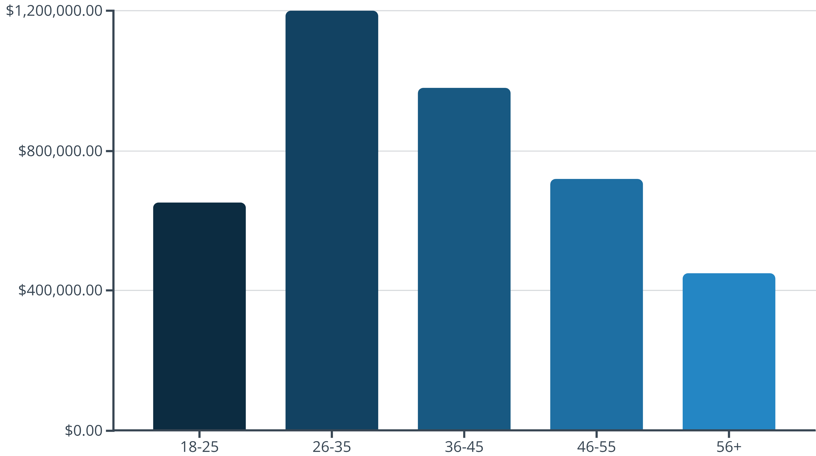
Revenue by Age Group
The 26-35 age group contributes the highest revenue, followed by 36-45, indicating prime targets for marketing campaigns and product development.

Slide 10





Strategic Recommendations
Boost Subscriptions
Promote exclusive benefits for subscribers to increase recurring revenue and customer lifetime value.
Customer Loyalty Programs
Reward repeat buyers to move them into the "Loyal" segment and increase retention rates.
Review Discount Policy
Balance sales boosts with margin control to optimize profitability without sacrificing volume.
Targeted Marketing
Focus efforts on high-revenue age groups (26-35) and express-shipping users for maximum ROI.

